Slide 1
Expressions in C

Slide 2

Lets start programming in C
Notes:
This presentation demonstrates the new capabilities of PowerPoint and it is best viewed in Slide Show. These slides are designed to give you great ideas for the presentations you’ll create in PowerPoint 2010!
For more sample templates, click the File tab, and then on the New tab, click Sample Templates.

Slide 3
1. Through this lecture, students will learn the syntax of C programming.
2. Students will understand the control flow of C program
Learning
Outcomes

Slide 4
Contents
Syntax of Program
Receiving Input and Output
Introduction to control flow of program

Slide 5
Lets build first C program
Rules applicable to all C programs:
Each instruction in a C program is written as a separate statement.
The statements in a program must appear in the same order in which we wish them to be executed except ‘jump’ , ‘goto’ is required.
Blank spaces may be inserted between two words to improve the readability of the statement.
All statements are entered in small case letters.
Every C statement must end with a ;. Thus ; acts as a statement terminator.
Comment about the program should be enclosed within /* */.
Comments cannot be nested.

Slide 6
Receiving input and displaying output
printf( ) function is used to display the value on the screen whose form is:
Syntax 1: printf ( “format specifiers”, value1, value2) ;
Syntax 2: printf(“ user defined message ”);
2. scanf( ) receives the input from the keyboard.
Syntax: scanf("format specifiers",&value1,&value2,.....);
ampersand (&) before the variables in the scanf( ) function is an ‘Address of’ operator which gives the location number used by the variable in memory.
3. Both are predefined function in "stdio.h" header file

Slide 7
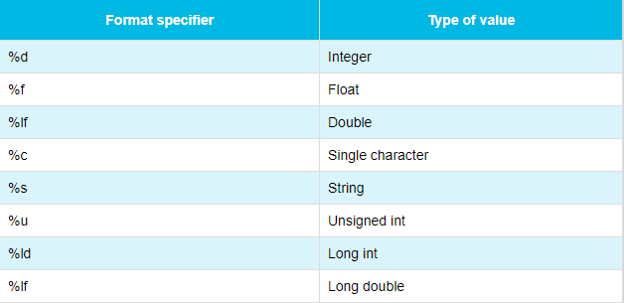

Slide 8
Compilation and Execution
Start the compiler at C> prompt
Select New from File menu
Use Ctrl+F9 to compile and execute the program
Type the program and save it using F2
Use Alt+F5 to view the output

Slide 9
Types of C instructions
Type declaration instruction
To declare the type of variables
Ex: int i=10, j=25;
Arithmetic instruction
To perform arithmetic operations between constants and variables
Ex: int i,j,k; k=i+j;
Control instruction
To control the sequence of execution of various statements
Sequence, Selection, Repetition, Case control Instruction

Slide 10
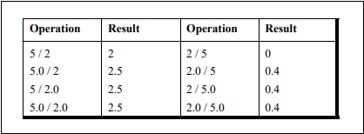
Integer and Float Conversions
An arithmetic operation between an integer and integer always yields an integer result.
An operation between a real and real always yields a real result.
An operation between an integer and real always yields a real result. In this operation the integer is first promoted to a real and then the operation is performed. Hence the result is real.

Slide 11
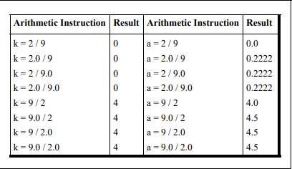
Lets have a look on these type conversions

Slide 12
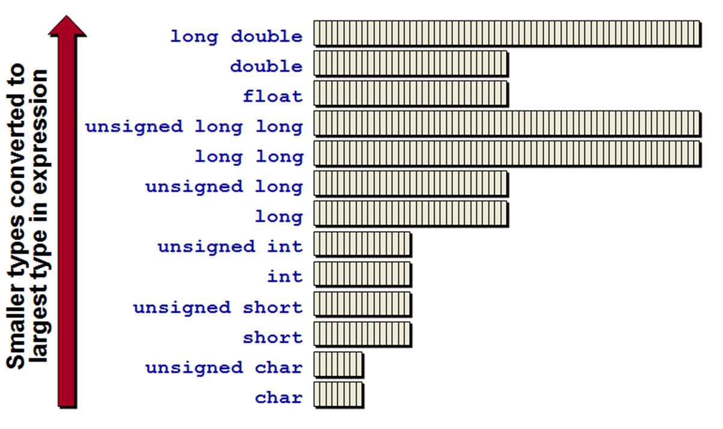
Implicit Type Conversions

Slide 13
automatic type conversion
Done by the compiler on its own, without any external trigger from the user
All the data types of the variables are upgraded to the data type of the variable with largest data type.
bool -> char -> short int -> int -> unsigned int -> long -> unsigned -> long long -> float -> double -> long double
possible for implicit conversions to lose information
signs can be lost (when signed is implicitly converted to unsigned),

Slide 14
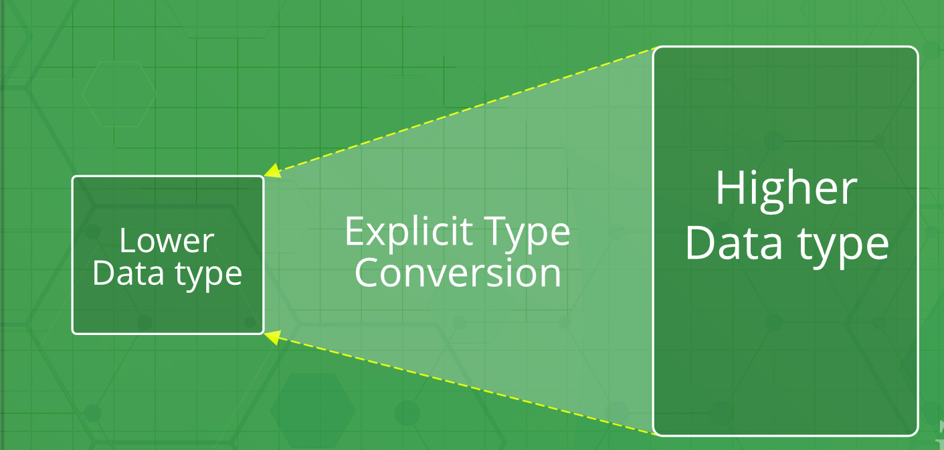
Explicit Type Conversion

Slide 15
Also called type casting
It is user defined
User can type cast the result to make it to a particular data type
Syntax:
(type) expression
Type indicated the data type to which the final result is converted
done to take advantage of certain features of type hierarchies or type representations

Slide 16
Type Casting vs Type Conversion
BASIS FOR COMPARISON | TYPE CASTING | TYPE CONVERSION
Definition | When a user can convert the one data type into other then it is called as the typecasting. | Type Conversion is that which automatically converts the one data type into another.
Implemented | Implemented on two ‘incompatible’ data types. | Implemented only when two data types are ‘compatible’.
Operator | For casting a data type to another, a casting operator ‘()’ is required. | No operator required.
Implemented | It is done during program designing. | It is done explicitly while compiling.
Conversion type | Narrowing conversion. | Widening conversion.
Example | int x; byte y; … … y= (byte) x; | int x=3; float y; y=a; // value in y=3.000.

Slide 17
Solve the following
A C program contains the following declarations:
int i,j;
long ix ;
short s;
float x;
double dx;
char c;
Determine the data type of each of the following expressions.
(a) i+ c
(b) x + c (f) i x + j
(c) dx + x (g) s + c
(d) ( ( int ) dx) + ix
(e) i+ x

Slide 18
Lets start writing small programs

Slide 19
Program to print an integer
#include <stdio.h>
int main()
{ int number;
// printf() dislpays the formatted output
printf("Enter an integer: ");
// scanf() reads the formatted input and stores them
scanf("%d", &number);
// printf() displays the formatted output
printf("You entered: %d", number);
return 0;
}

Slide 20
Program to add two integers
# include <stdio.h>
int main()
{
int firstNumber, secondNumber, sumOfTwoNumbers;
printf("Enter two integers: ");
// Two integers entered by user is stored using scanf() function
scanf("%d %d", &firstNumber, &secondNumber);
// sum of two numbers in stored in variable sumOfTwoNumbers
sumOfTwoNumbers = firstNumber + secondNumber;
// Displays sum
printf("%d + %d = %d", firstNumber, secondNumber, sumOfTwoNumbers);
return 0;
}

Slide 21
Program to multiply two floating point integers
#include <stdio.h>
int main()
{ double firstNumber, secondNumber, product;
printf("Enter two numbers: ");
// Stores two floating point numbers in variable firstNumber and secondNumber respectively
scanf("%lf %lf", &firstNumber, &secondNumber);
// Performs multiplication and stores the result in variable productOfTwoNumbers
product = firstNumber * secondNumber;
// Result up to 2 decimal point is displayed using %.2lf
printf("Product = %.2lf", product);
return 0; }

Slide 22
Program to print ASCII value of a character
#include <stdio.h>
int main()
{ char c;
printf("Enter a character: ");
// Reads character input from the user
scanf("%c", &c);
// %d displays the integer value of a character
// %c displays the actual character
printf("ASCII value of %c = %d", c, c);
return 0;
}

Slide 23
Program to compute Quotient and Remainder
#include <stdio.h>
int main()
{ int dividend, divisor, quotient, remainder;
printf("Enter dividend: ");
scanf("%d", &dividend);
printf("Enter divisor: ");
scanf("%d", &divisor);
// Computes quotient
quotient = dividend / divisor;
// Computes remainder
remainder = dividend % divisor;
printf("Quotient = %d\n", quotient);
printf("Remainder = %d", remainder);
return 0;
}

Slide 24
Program to find the size of all data types
#include <stdio.h>
int main()
{
int a; long b; long long c; double e; long double f;
printf("Size of int = %ld bytes \n", sizeof(a));
printf("Size of long = %ld bytes\n", sizeof(b));
printf("Size of long long = %ld bytes\n", sizeof(c));
printf("Size of double = %ld bytes\n", sizeof(e));
printf("Size of long double = %ld bytes\n", sizeof(f));
return 0;
}

Slide 25
Program to swap two numbers
Program to calculate the volume of sphere
In Class Programs to do

Slide 26

Quiz

Slide 27
Q1. What will be the output of following program:
main( )
{ int i = 2, j = 3, k, l ;
float a, b ;
k = i / j * j ;
l = j / i * i ;
a = i / j * j ;
b = j / i * i ;
printf( "%d %d %f %f", k, l, a, b ) ;
}
main( )
{ float a = 5, b = 2 ;
int c ;
c = a % b ;
printf ( "%d", c ) ;
}

Slide 28
Which is a valid typecast?
A. a(char);
B. char:a;
C. (char)a;
D. to(char, a);
main( )
{ printf ( "nn \n\n nn\n" ) ;
printf ( "nn /n/n nn/n" ) ; }
e) main( )
{ int p, q ;
printf ( "Enter values of p and q" ) ;
scanf ( " %d %d ", p, q ) ;
printf ( "p = %d q =%d", p, q ) ; }

Slide 29
Thank You......

